Slide 1
Excel Lesson 2 Changing the Appearance of a Worksheet
Microsoft Office 2010 Introductory
Pasewark & Pasewark

Slide 2
Objectives
Change column widths and row heights.
Position data within a cell by aligning, wrapping, rotating, and indenting.
Change the appearance of cells using fonts, font sizes, font styles, colors, and borders.
Designate the number format used for data stored in a cell.
2
2

Slide 3
Objectives (continued)
Use the Format Painter to copy formatting from one cell to another.
Apply and clear cell styles.
Find and replace cell formats.
3
3

Slide 4
Vocabulary
align
AutoFit
border
cell style
clear
column heading
fill
font
font size
font style
Format Painter
indent
merge
number format
4
4

Slide 5
Vocabulary (continued)
orientation
row heading
style
theme
truncate
wrap text
5
5

Slide 6
Resizing Columns and Rows
Resize a column by placing the pointer on the right edge of the column heading and dragging. For a precise column width, enter the value in the Column Width dialog box.
To change the row height, drag the border of the row heading or enter a height in the Row Height dialog box.
6
6

Slide 7
Resizing Columns and Rows (continued)
AutoFit determines the best width for a column or the best height for a row.
Place the pointer on the right edge of the column heading (or below the row heading) until the pointer changes to a double-headed arrow. Then, double-click to resize the column or row to the best fit.
7
7

Slide 8
Positioning Data Within a Cell
By default, text you enter in a cell is lined up along the bottom-left side of the cell, and numbers you enter in a cell are lined up along the bottom-right.
However, you can position data within a cell in a variety of ways using the buttons on the Home tab of the Ribbon.
8
8

Slide 9
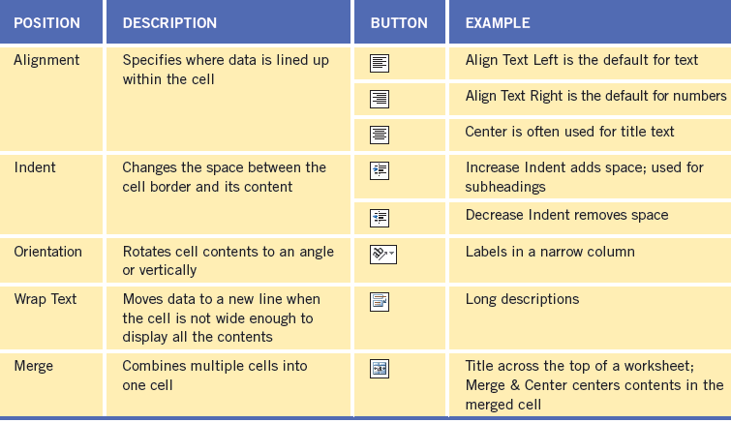
Positioning Data Within a Cell (continued)
Positioning data within a cell

Slide 10
Positioning Data Within a Cell (continued)
You can align the contents of a cell horizontally and vertically within the cell. To change the alignment of a cell, select the cell and then click an alignment button on the Home tab.
You can also merge cells which combines them into one cell.
Indent data within cells by using the Increase Indent and Decrease Indent buttons on the Home tab.
10
10

Slide 11
Positioning Data Within a Cell (continued)
You can change a cell’s text orientation.
Text that doesn’t fit in a cell is displayed in the next cell, if empty. If the next cell contains data, any text that does not fit is truncated, or hidden from view.
To see all the text stored in a cell you can wrap text. The row height increases to display additional lines.
11
11

Slide 12
Changing the Appearance of Cells
A theme is a preset collection of design elements, including fonts, colors, and effects.
As you format cells, Live Preview shows the results of the different formatting options.
A font is the design of text. The default font for cells is Calibri.
Font size determines the height of characters in points (default size for cells is 11 points).
12
12

Slide 13
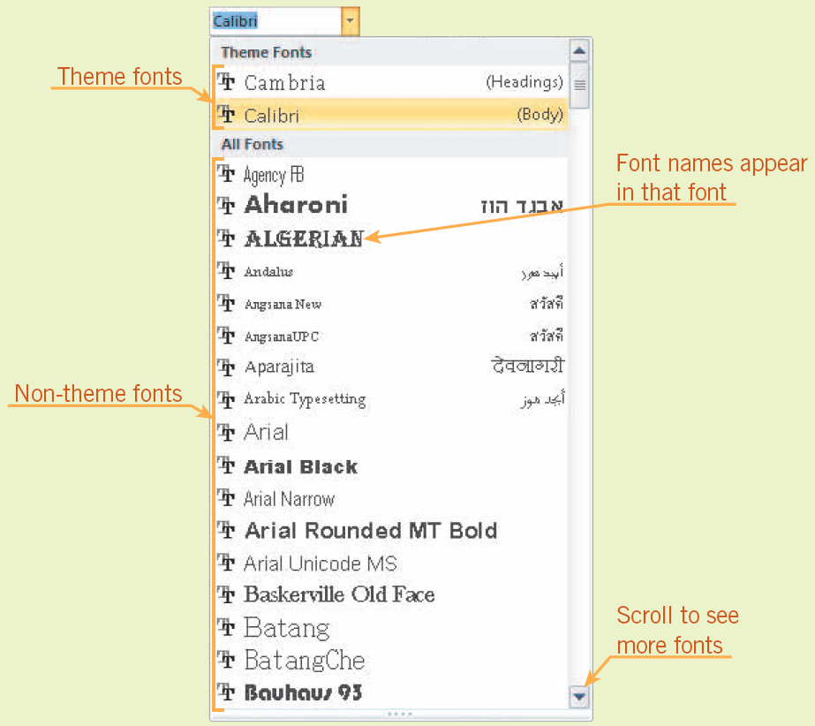
Changing the Appearance of Cells (continued)
Font gallery

Slide 14
Changing the Appearance of Cells (continued)
Bold, italic, and underlining can add emphasis to the contents of a cell. These features are referred to as font styles.
You can use color to emphasize cells. The default font color is black and the default fill (background) color is white. Both colors can be changed.
You can add emphasis to a cell by applying a border (or line) around its edges.
14
14

Slide 15
Changing the Appearance of Cells (continued)
Number formats change the way data looks in a cell. The actual content you entered is not changed.
The default number format is General, which displays numbers the way you enter them.
15
15

Slide 16
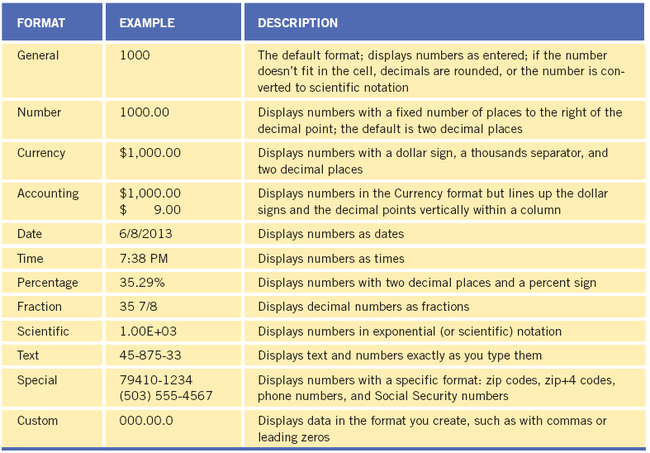
Changing the Appearance of Cells (continued)
Number formats

Slide 17
Changing the Appearance of Cells (continued)
The Format Painter enables you to copy formatting from one cell and paste it to other cells without pasting the first cell’s contents.
The format cells dialog box provides access to all the formatting options available on the ribbon, as well as some additional options.
17
17

Slide 18
Using Styles to Format Cells
A style is a combination of formatting characteristics.
A cell style is a collection of formatting characteristics you apply to a cell or range of data.
To remove, or clear, all the formatting applied to a cell or range of cells, use the Clear button on the Home tab.
18
18

Slide 19
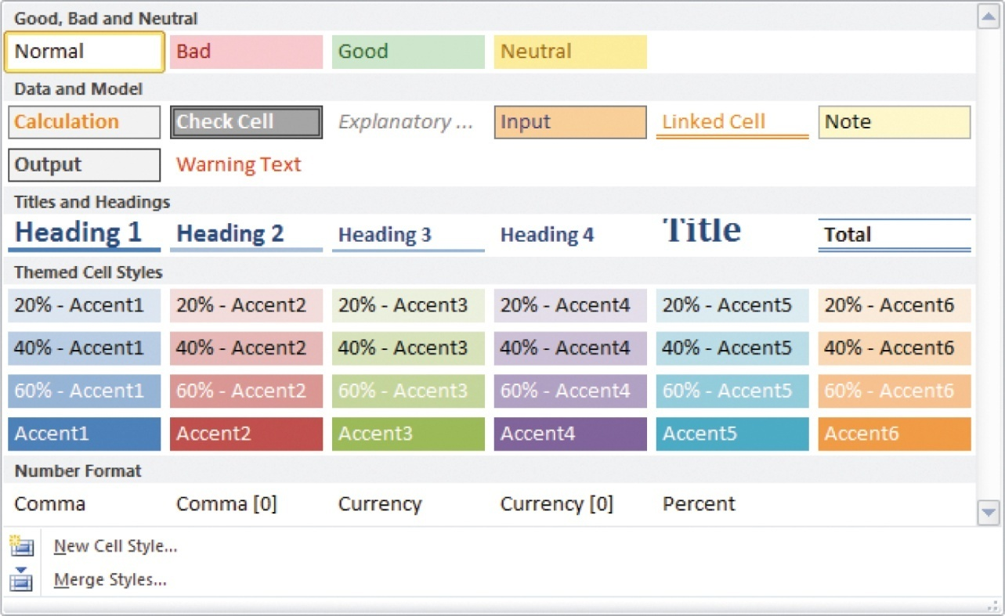
Using Styles to Format Cells (continued)
Cell styles gallery

Slide 20
Summary
In this lesson, you learned:
If data does not fit in a cell, you can resize the columns and rows to make the data easier to read.
You can align, indent, rotate, wrap text, and merge cells to reposition data in worksheet cells.
You can change the appearance of cells to make the worksheet easier to read or to create a specific look and feel. Choose the appropriate fonts, font sizes, font styles, font and fill colors, and borders.
20
20

Slide 21
Summary (continued)
Using a number format enables you to change how a number is displayed in a cell. No matter which number format you select, the actual value stored in the cell does not change. You can see this by comparing the formatted value in the active cell with the value displayed in the Formula Bar.
Format Painter copies all the formatting from one cell and pastes it to another cell or range without copying the contents of the cell.
21
21

Slide 22
Summary (continued)
The Format Cells dialog box provides all the number, alignment, font, border, and fill formatting options available on the Ribbon, as well as some additional options.
A style is a combination of formatting characteristics, such as alignment, font, font size, font color, fill color, and borders that you can apply simultaneously. The Cell Styles gallery lets you quickly apply a style to selected cells or create a new style.
22
22

Slide 23
Summary (continued)
You can use the Find and Replace dialog box to find and replace cell formatting.
23
23

